Slide 1
Country Impacted by Socio-Economic Factors
Renu S Thakur

Slide 2

Introduction
HELP International is an international humanitarian NGO that is committed to fighting poverty and providing the people of backward countries with basic amenities and relief during the time of disasters and natural calamities.
CEO of the NGO needs to decide how to use this money strategically and effectively.
As part of this study Top 10 countries are suggested for aid

Slide 3
Solution Approach
Data Set Review
Data Quality Checks & Cleanup
Outlier handling via capping method
EDA
Hopkins Cluster Tendency
Silhouette Score for number of cluster identification
K Means Clustering
Hierarchical Clustering using Single and Complete Linkage
Cluster Profiling
Identify the Countries

Slide 4
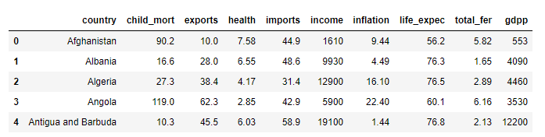
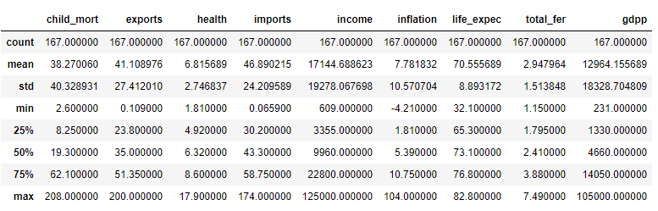
Data Set Review
167 countries with 9 socio-economic factors
All fields are fully populated , lot of outliers in dataset

Slide 5
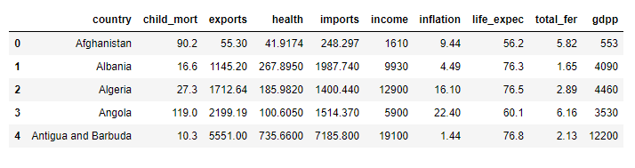
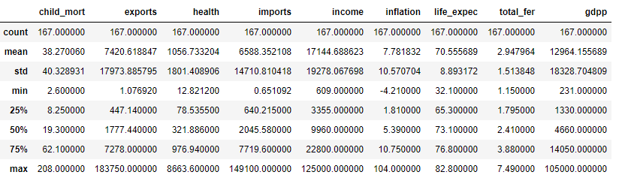
Data Set Quality & Cleanup
Dataset after converting exports , health & imports based on % of GDP

Slide 6
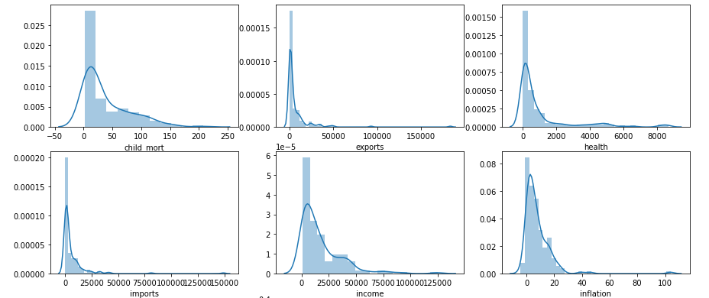
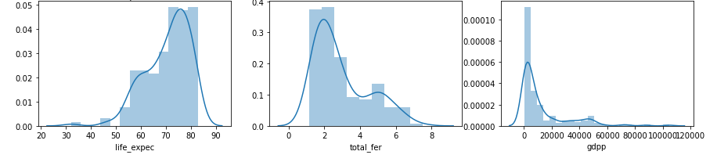
Data Distribution before Outlier handling

Slide 7
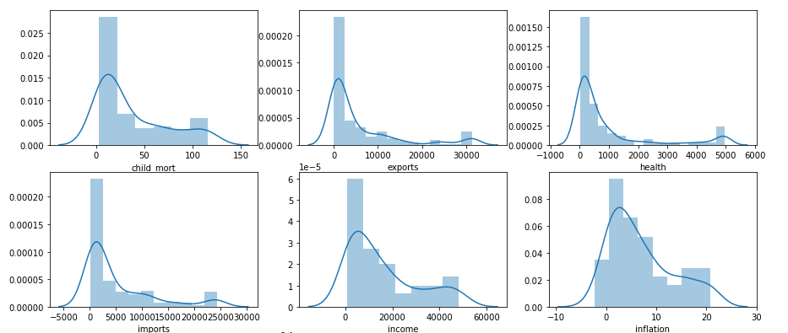
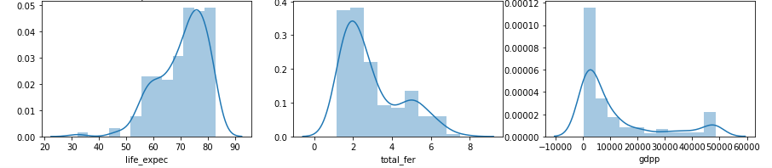
Data Distribution after Outlier handling

Slide 8
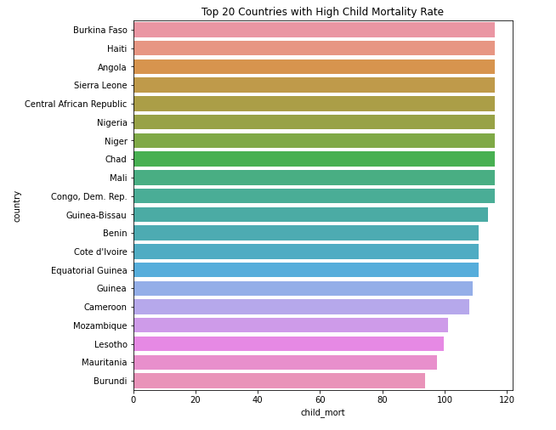
Country Analysis

Slide 9
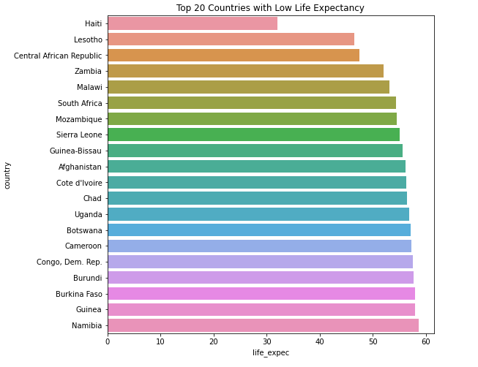
Country Analysis

Slide 10
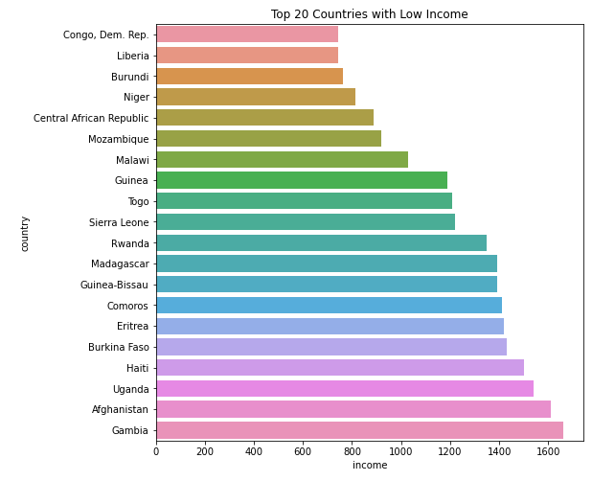
Country Analysis

Slide 11
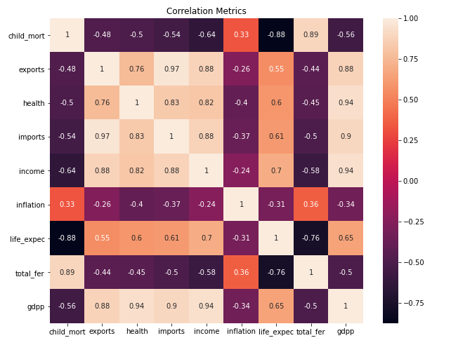
Correlation between different variables
GDP is highly correlation to exports , health , income
GDP negatively correlated to child mortality , inflation and total fertility
There is high negative correlation between child mortality and life expectancy
Import and Export are also highly correlated

Slide 12
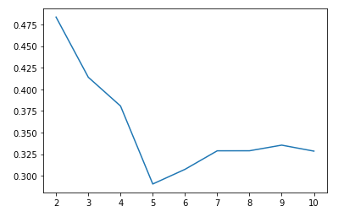
Silhouette Score & K Means
Based on Silhouette Score, ideal cluster size is 3
Clusters are formed based on 9 variables using K-Means Algorithm

Slide 13
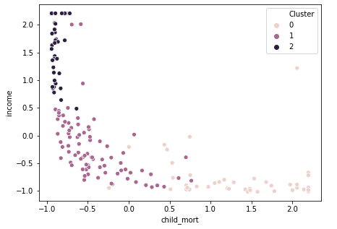
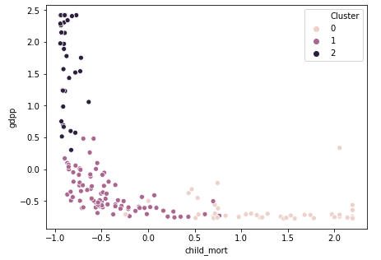
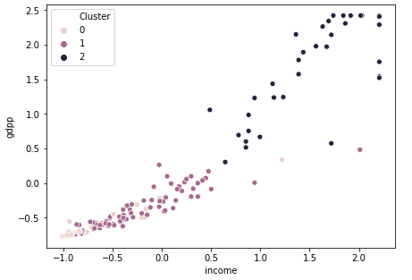
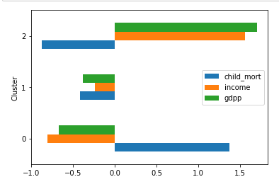
Cluster Profile

Slide 14
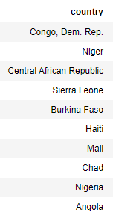
Top 10 Countries with High Child Mortality, Low Income & GDP

Slide 15
Total Countries
Afghanistan | Ghana | Pakistan
Angola | Guinea | Rwanda
Benin | Guinea-Bissau | Senegal
Burkina Faso | Haiti | Sierra Leone
Burundi | Kenya | Sudan
Cameroon | Lao | Tanzania
Central African Republic | Lesotho | Timor-Leste
Chad | Liberia | Togo
Comoros | Madagascar | Uganda
Congo, Dem. Rep. | Malawi | Yemen
Congo, Rep. | Mali | Zambia
Cote d'Ivoire | Mauritania | Eritrea
Equatorial Guinea | Mozambique | Gambia
Nigeria | Niger

Slide 16
Thank You

